Slide 1
Knapsack Problem
Fill the knapsack such that value is maximum,
Total weight is at most W.
Items can be broken down to maximize the knapsack value.
Weight = w1
Value = v1
Weight = w2
Value = v2
Capacity = W
Weight = w3
Value = v3

Slide 2

Example
A
B
C
Weight =10
Value =60
Weight =20
Value =100
Weight =30
Value =120
0-1 knapsack
Fractional knapsack
TAKE B and C
Total Weight = 20+30= 50
Total Value = 100+120= 220
TAKE A, B and 2/3rd of C
Total Weight = 10+20+30*(2/3)= 50
Total Value = 60+100+80= 240

Slide 3

Solution
A
B
C
60/10
100/20
120/4
Ratio =6
Ratio =5
Ratio =4
Calculate the ratio (value/weight) for each item and Sort(descending) based on ratio
Take item with highest ratio and add to knapsack until we can’t add the next item as whole
At the end add the next item as much(fraction) as we can.
Take 2/3rd of C
Weight: 2/3*30 = 20
Value: 2/3 *120 = 80

Slide 4
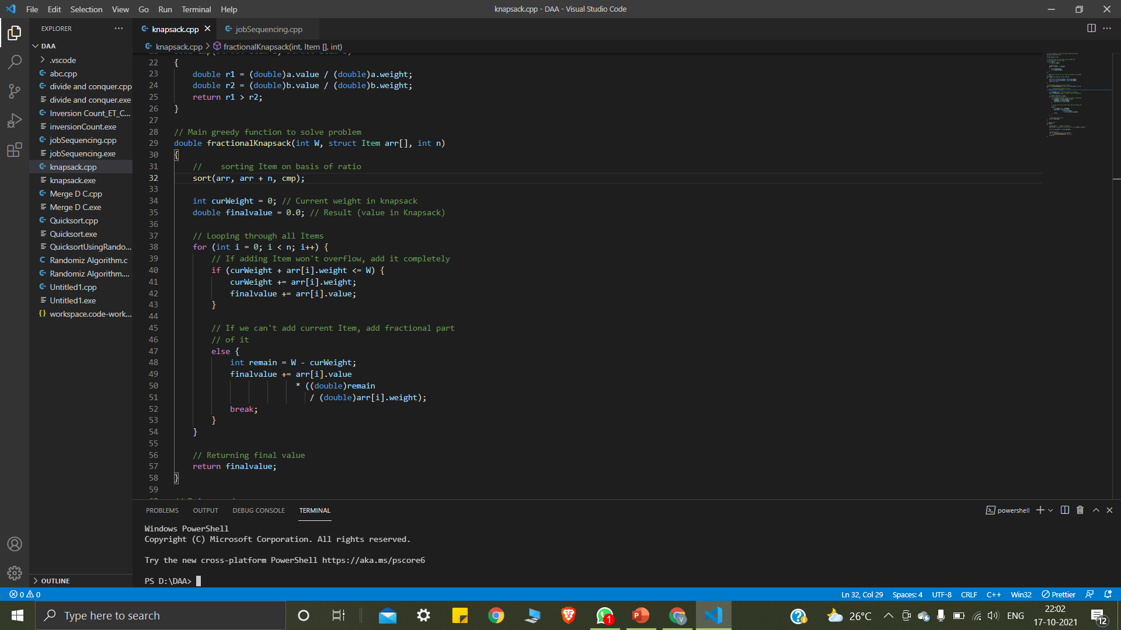
Approach
Calculate the ratio(value/weight) for each item.
Sort the item based on this ratio.
Take the item with highest ratio and add them until we cant add the next item as whole.
At the end add the next item as much(fraction) as we can

Slide 5


Job Sequencing Problem
Given an array of jobs where every job has a deadline and associated profit if the job is finished before the deadline. It is also given that every job takes single unit of time, so the minimum possible deadline for any job is 1. How to maximize total profit if only one job can be scheduled at a time
Example:
Job id | A | B | C | D | E
Deadline | 2 | 1 | 2 | 1 | 3
Profit | 100 | 19 | 27 | 25 | 15

Slide 6

Solution
Step 1: Sort all jobs in decreasing order of profit
Job id | A | B | C | D | E
Deadline | 2 | 1 | 2 | 1 | 3
Profit | 100 | 19 | 27 | 25 | 15
Job id | A | B | C | D | E
Deadline | 2 | 2 | 1 | 1 | 3
Profit | 100 | 27 | 25 | 19 | 15
Sorted

Slide 7
Continued
Step 2. Initialize the result sequence as first job in sorted jobs.
Job id | A | C | D | B | E
Deadline | 2 | 2 | 1 | 1 | 3
Profit | 100 | 27 | 25 | 19 | 15
0
1
2
3
4
5
Result
C
A
D

Slide 8
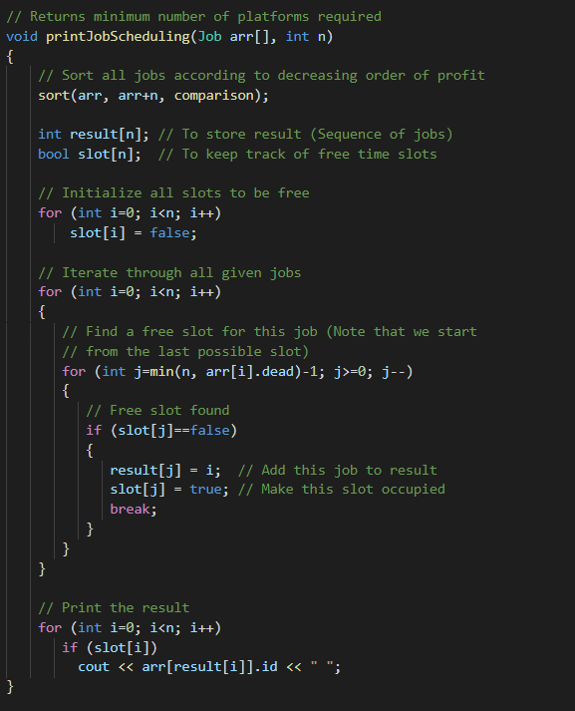
Approach
Sort all jobs in decreasing order of profit
Initialize the result sequence as first job in sorted jobs
Do the following for remaining n-1 jobs
If the current job can fit in the current result sequence without missing the deadline, add current job to the result, else ignore the current job.

Slide 9
